Slide 1
Stem Portal Resources
By Xiangyu Li, Jonathan Fernandez, and Kelley Chu

Slide 2
Introduction
What is STEM? (Science, Technology, Engineering, Math)
How does UC Davis interpret STEM?
We scraped all the resources in the UC Davis STEM portal
For the project, our group “Sweet Cheetos” was assigned the UC Davis Stem Portal. In today’s standards, just about anything can be considered STEM. Only topics in the science, technology, engineering, and math areas would be considered as STEM subjects. One example is the recent expansion of STEM topics at UC Davis and how economics degree is now considered a STEM degree. Keeping this in mind, we made our goal for this project to try to understand how UC Davis interprets STEM.

Slide 3
Methods
Qualitative question -> Quantitative indicator -> Qualitative Evaluation
Approaches we have considered
Distribute STEM Portal evaluation questionnaires to a large number of UC Davis students.
The questions are about the student's personal information, the experience of using STEM Portal , and the personal rating of STEM Portal Websites.
Calculate the rating average, median, and standard deviation based on the ratings of each question.

Slide 4
Methods
The approach that went as planned
Find out how these pages reflect the theme of STEM based on an assessment of the frequency and number of text and words appearing on STEM Portal pages.
First level: https://stem.ucdavis.edu/resources/ (215 links total)
We created in total 215 folders and stored all of the text that were scraped from these links
We later cleaned the raw text and store the newly clean text
Second level: iterate through 215 links to find all the working links
Once we found all of the working links, we created a folder and stored the text.
We later cleaned the stored text (also known as raw text) and then filed the cleaned text.
4966 folders and 9932 files

Slide 5
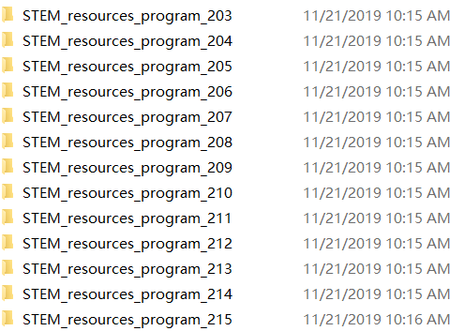
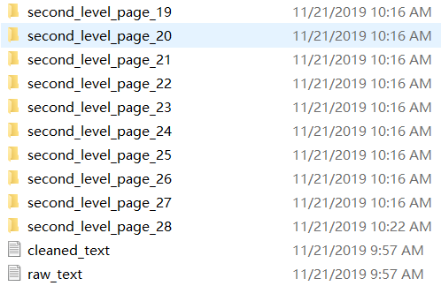
Methods
First Level
Second Level

Slide 6

Methods
Clean the text
Convert all uppercase letters to lowercase letters for uniformity.
Remove all English stop words from the text.
Set up a blacklist to eliminate words in the text that we find meaningless.
Replace all numbers with the form "#numeric" and remove all punctuation.
Collapse multiple spaces and trimmed leading and trailing spaces.

Slide 7
Methods
Limitations
Blacklist for both of the levels may not be accurate.
There are many duplicate urls (ex. stem.ucdavis.edu.) in the second level pages

Slide 8
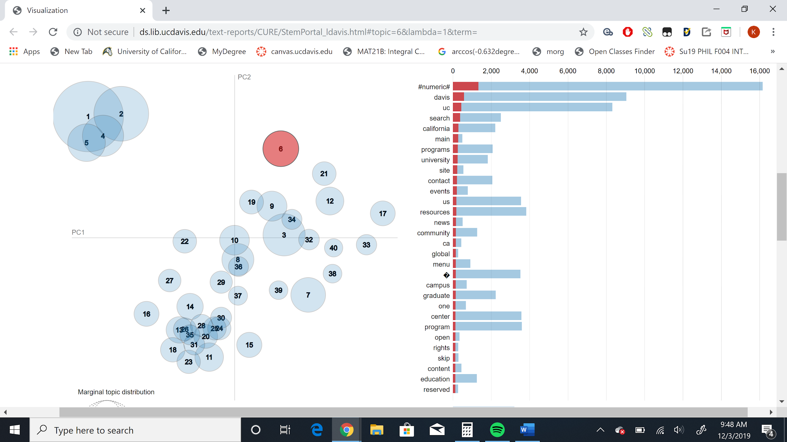
Results

Slide 9
Results
From our Data Visualization
There appears to be some clusters
One in the first quadrant
Very generic, the most common words being UC Davis, stem, and science
Can guess it is probably an introductory page
One in the third quadrant
More specific, with common words engineering, data, and business
Probably more specific topics in stem
One bordering the second and third quadrant
Specific, mostly with words dealing with environmental sciences and agriculture

Slide 10
interpretations
There are many topics as expected
Engineering, health, agriculture
Unexpected topics
business , economics
Davis has reclassified the economics major as a STEM degree because it follows from a revision in the degree federal Classification of Instructional Programs (CIP) code
The new STEM designation also helps international students stay in the U.S on their F-1 visas
Should include a tab for economics/business

Slide 11
Defeat
Kelley Chu:
Had a lot of problems organizing the written text files while coding
Xiangyu Li:
Bad choice of the word blacklist made the final result worse
Jonathan Fernandez:
Too slow to understand coding thus being behind during the coding process and not being much help when code is being slung

Slide 12
Victory
Jonathan Fernandez
Learning something new!
Kelley Chu
Interpretation of the visual data
Xiangyu Li
Understand what is a research

